Slide 1
CAPSTONE PROJECT
Price range prediction of mobile phone
SHAJAD

Slide 2
Table of content
Objective
Data Summary
Data loading and exploration
Data Wrangling
Column wise analysis
Feature engineering
Algorithm results
Algorithm that we use
Technique and methods we used
Challenges
Reference
Conclusion

Slide 3
Objective
In the competitive mobile phone market company wants to understand sale data of the mobile phone and factors which drive the prices. The objective is to find out some relation ship between features of mobile phones ( eg. — RAM, internal memory, etc.). and its selling price. In this problem we do not have to predict the actual price but a price range indicating how high the price is.
Our objective is to find out the best price range to competitive with other in mobile phone market and find out which features affect the price range and sales

Slide 4
Data summary
Battery power → battery power in mAh
Blue → Has Bluetooth or not
Clock speed → Speed at which microprocessor execute instruction
Dual sim → Has dual sim or not
Fc → front camera megapixels
Pc → Primary camera pixels
Four g → has 4g or not
Int memory → internal memory capacity
M deep → mobile depth in cm
Mobile weight → weight of mobile phones
N cores → no. of cores in processor
Px width → pixel resolution width
Px height → pixel resolution height

Slide 5
Ram → random access memory in mb
Sc w → screen width
Talk time → Longest that a single battery can last over a call
Three g → has 3g or not
Wifi → has wifi or not
Price range → This is the target variables with a value of (0=low cost),(1=medium cost),(2=heigh cost),(3=very heigh cost)

Slide 6
Data loading
Data loading
Loading the data from google drive and read into notebook
Data exploration
Checking data in different column
Data operations
Cloumns
Numerical columns and the cetagorical columns
Data
Information and data type of columns

Slide 7
Data wrangling
Data wrangling-also called data cleaning, unifying messy and complex data sets to a meaningful format for easy access and analysis. There are various processes designed to transform raw data into more readily used formats.
*It includes following steps:
Creating columns to better understanding.
Remove the columns that used to create the new columns.
Converting columns to proper data type format.
Adding or removing columns for analysis.

Slide 8
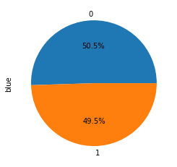
Column wise analysis
In this pie plot we see that half of the phone don’t have the bluetooth there are 50.5% phones have bluetooth and 49.5% phones are bluetooth less.

Slide 9
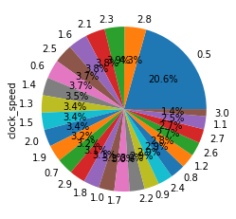
In this pie chart we shoe the major phones have the 0.5 clock speed , it means that the 0.5 clock speed are mostly used in the phones.

Slide 10
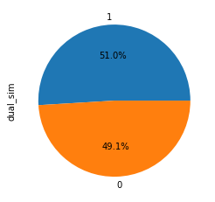
according to this chart 51% phone have dual sim support and 49% phones are single sim supporter

Slide 11
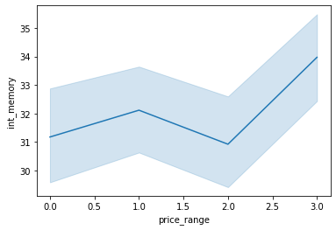
In this chart we can show price range 1 and there

Slide 12
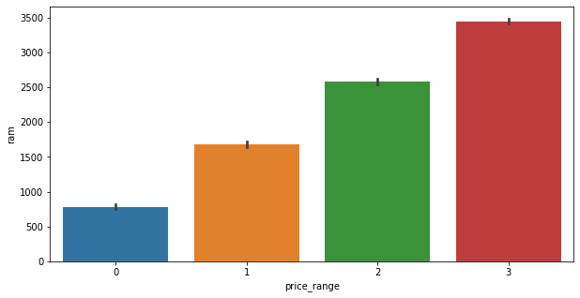
in this chart we show that price range and ram have linear corrilation ram will increase if we increase the ram

Slide 13
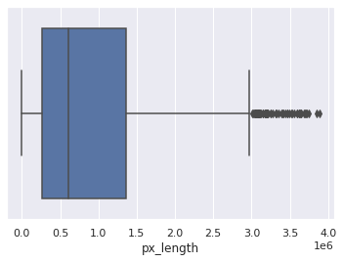
In this box plot we see that some outlier are finds after the 3.0 px length.

Slide 14
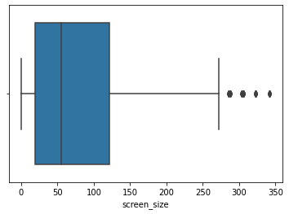
We drow the boxplot to finde the outliers and we found some outlier after the 270 according to this chart

Slide 15
Feature Engineering
We convert the px. height and px. width into px. length.
We convert the four g and three g into phone g.
We convert the sc. w and sc. h into screen size.
We delete the duplicate columns.
We remove the unnecessary data points.
We add and delete the some columns.
We split the data into Train dataset and the test dataset

Slide 16
Algorithm that we use
1st we use KNN algorithm in this task
2nd we use SVM
3rd we use Decision tree
4th Bagging
5th algorithm that we use is Random forest
6th algorithm is Gradient boosting
In this task we use 7th XG boost

Slide 17
Algorithm result
NO. | Algorithm | MAE | MSE | R2 | Accuracy
1 | KNN | 0.988 | 1.722 | -0.578
2 | SVM | 1.44 | 3.225 | -1.823 | 0.26
3 | Decision tree | 0.122 | 0.122 | 0.8927 | 0.88
4 | Bagging | 0.122 | 0.122 | 0.8927 | 0.88
5 | Random forest | 0.115 | 0.115 | 0.8993 | 0.89
6 | Gradient boost | 0.09 | 0.09 | 0.92121 | 0.91
7 | XG Boost | 0.092 | 0.092 | 0.9190 | 0.91

Slide 18
Technique and methods we used
1st we decide the X variables and the Y variables
Then we divide the data into 2 parts Train dataset and the test dataset
And we took the 80 percent data as training data and 20 percent data as a test data
Abd we use the standard scaler as a scaler
Metrics that we are use in this project is 1)r2_score, 2)mean squared error, 3)mean absolute error, 4)accuracy score.
In this project we use KNN, SVM, decision tree, random forest, XG boost Gradient boosting, bagging etc.

Slide 19
Challenges
When we start this project the data is very complex and not easy to under stand.
In this project the best part is to plotting the right plot and find the inside information about the features.
After plot the graph we do some feature engineering and make some columns and some colums also delete.
And finally we apply the algorithm on the data

Slide 20
Conclusion
This project is about the price range prediction of mobile price range analysis. When we start this project it is very difficult to understand and look very complex. In first step we upload the data and then we start to find the duplicate values and nulls values and missing values etc. but in this data there is no missing values and duplicate values. After completion of 1st step in 2nd step we pot the data in form of graph pie plot and bar plot and line plot and also box plot and in box plot we find some outlier but these outliers are not affect the result because thy are very less in number. After plot the data we plot the heatmap of the data and then we find the relationship between the feature and we did some feature engineering in the data like combine the features and make another feature etc. After the feature engineering we apply some algorithm, 1)KNN , 2)SVM ,3)decision tree, 4)random forest, 5) bagging, 6)sacking,7)XG booster, 8) Gradient boosting. After applying these algorithm we select the best 3 algorithm that gives the best accuracy score. And we select the XG boost, random forest, gradient boosting the give the accuracy between the 88- 91 percent. After selecting the algorithm we do some feature engineering and do some cross validation but there is not much change in the result of the cross validation and we select all as a best that give us 91% accuracy score.

Slide 21
Reference
Almabetter
Geeksforgeeks
StackOverflow
Github

Slide 22
THANK YOU

